Slide 1

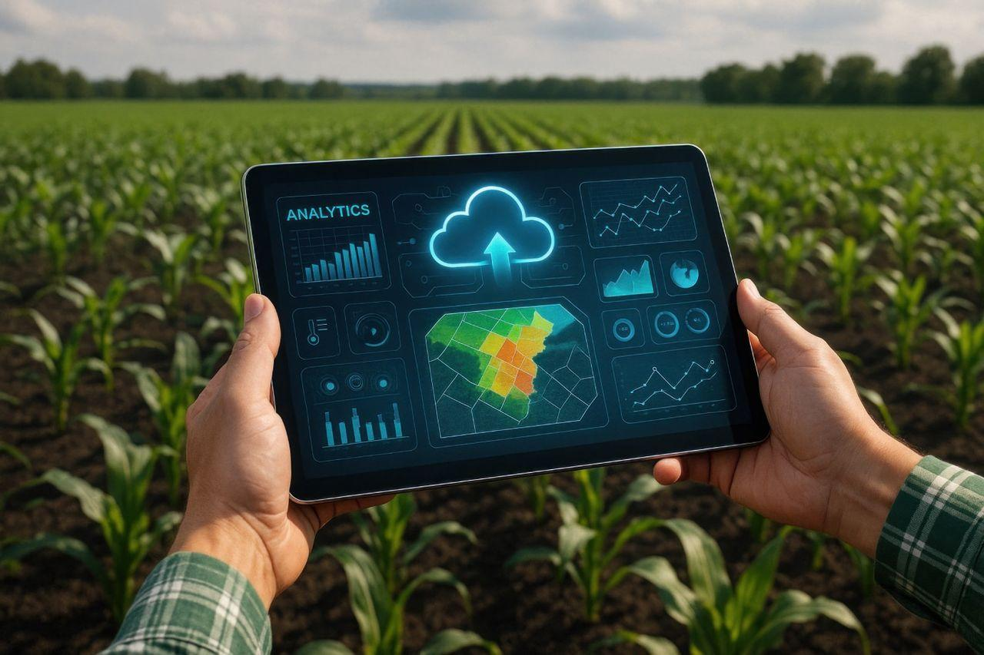
AgriVision: A Data Science–Driven Sustainable Agricultural Analytics and Visualization Platform
DSA0405 – Fundamentals of Data Science
Guided by:
Dr. Krishnaraj Mony
Associate Professor/CSE
Presented by:
Sancia Sanky(192572005)
Pooja S(192524211)
S.Sirivally(192472371)

Slide 2


INTRODUCTION
Agriculture generates large volumes of data related to crops, production, soil, and other agricultural factors.
Manual analysis of such data can be time-consuming and may not provide clear insights.
AgriVision is a data-driven agricultural analysis platform designed to simplify the processing and understanding of agricultural datasets.
The system enables users to upload datasets, perform data analysis, visualize results through charts, and access insights through a dashboard.
It helps transform raw agricultural data into meaningful information to support better and more informed decision-making.

Slide 3
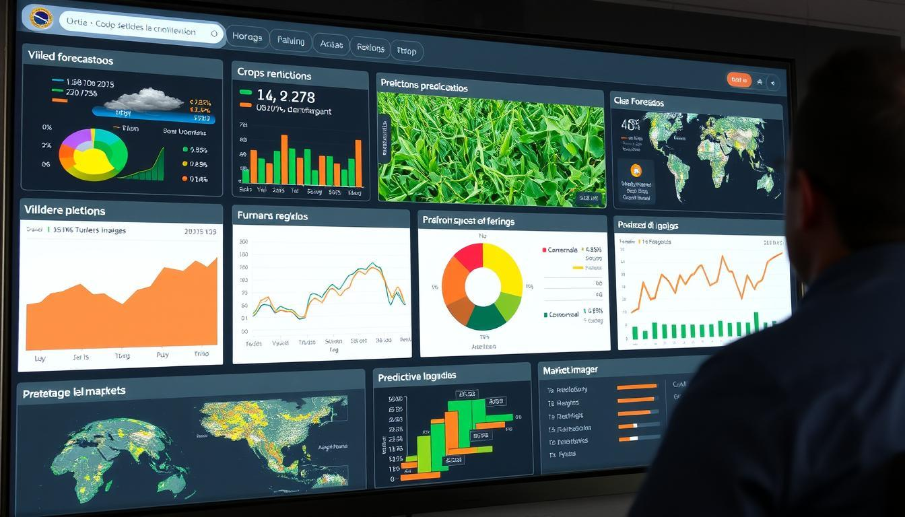
OBJECTIVES
Dataset Management: Enable users to upload and manage agricultural datasets efficiently.
Data Analysis: Process and analyze agricultural data to identify meaningful patterns and insights.
Interactive Dashboard: Present important data and analysis results through an easy-to-understand dashboard.
Data Visualization: Generate charts and visual representations to simplify the interpretation of agricultural data.
Report Generation: Provide analyzed results and reports to support informed decision-making.

Slide 4
LITERATURE SURVEY
S.No | Title | Authors | Year | Techniques Used | Problem Addressed
1 | Predicting Sustainable Crop Yields: Deep Learning and Explainable AI Tools | I. Malashin et al. | 2024 | Deep Learning, XAI | Models can be complex and difficult for users to interpret.
2 | Applications of Artificial Intelligence, Machine Learning, and Deep Learning in Plant Breeding | M. Eftekhari et al. | 2024 | AI, ML, Deep Learning | Integrating and interpreting large agricultural datasets remains challenging.
3 | A Comparative Study of Machine Learning Models in Predicting Crop Yield | B. M. Lionel et al. | 2025 | Machine Learning, Regression | Different models perform differently across datasets, requiring suitable model selection and evaluation.
4 | Enhancing Crop Yield Prediction Through Machine Learning Regression Analysis | S. Sharma et al. | 2025 | ML Regression | Agricultural datasets require effective preprocessing and analysis before prediction.
5 | Interpretable Machine Learning for Legume Yield Prediction Using Satellite Remote Sensing Data | T. Petropoulos et al. | 2025 | Interpretable ML, Remote Sensing | Advanced prediction methods still require better interpretability for practical agricultural decision-making.

Slide 5
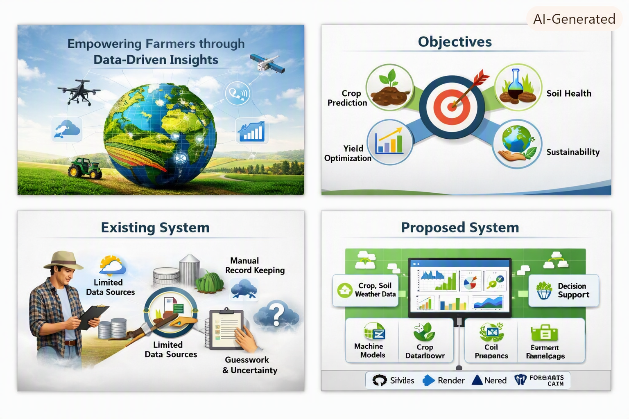
EXISTING SYSTEM
Agricultural data is often stored in different files and formats, making it difficult to manage and analyze.
Manual data analysis can be time-consuming and may not provide clear insights.
Existing approaches may lack an integrated platform for data upload, analysis, visualization, and reporting.
Understanding large datasets without proper charts and dashboards can be difficult.
There is a need for a centralized system that transforms raw agricultural data into meaningful insights for better decision-making.

Slide 6
PROPOSED SYSTEM
Upload agricultural datasets through a simple and user-friendly interface.
Process and analyze data to identify patterns, trends, and useful insights.
Perform statistical and exploratory data analysis for better understanding of the dataset.
Visualize results using dashboards, charts, and graphical representations.
Generate reports and analytical outputs to support informed agricultural decision-making.

Slide 7

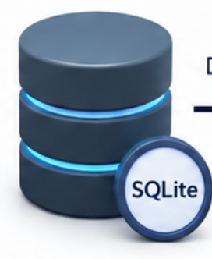
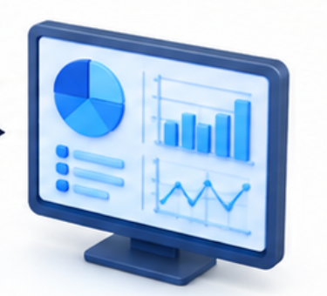


SYSTEM ARCHITECTURE
1. USER
• Upload Dataset • View Dashboard • Perform Analysis • Access Reports
2. FRONTEND React.js
• User Interface • Dataset Upload • Dashboard • Data Visualization
3.BACKEND SERVER FastAPI | Python
• Handle API Requests • Data Processing • Perform Analysis • Generate Charts & Reports
4. DATABASE
DATABASE SQLite
• Store Datasets • Store Analysis Results • Retrieve Data
5. OUTPUT
OUTPUT
• Interactive Dashboard • Charts & Visualizations • Analysis Results • Generated Reports

Slide 8
MODULE 1: Dataset Upload and Data Preprocessing
This module allows users to upload agricultural datasets in CSV format. The system validates the uploaded file and checks whether the required agricultural attributes are available. Data preprocessing is then performed to identify missing values, duplicate records, and outliers. The dataset columns are mapped into a standardized format for further analysis.
Key Functions:
CSV dataset upload
File validation
Column mapping
Missing value detection
Duplicate row detection
Outlier detection
Dataset preview

Slide 9
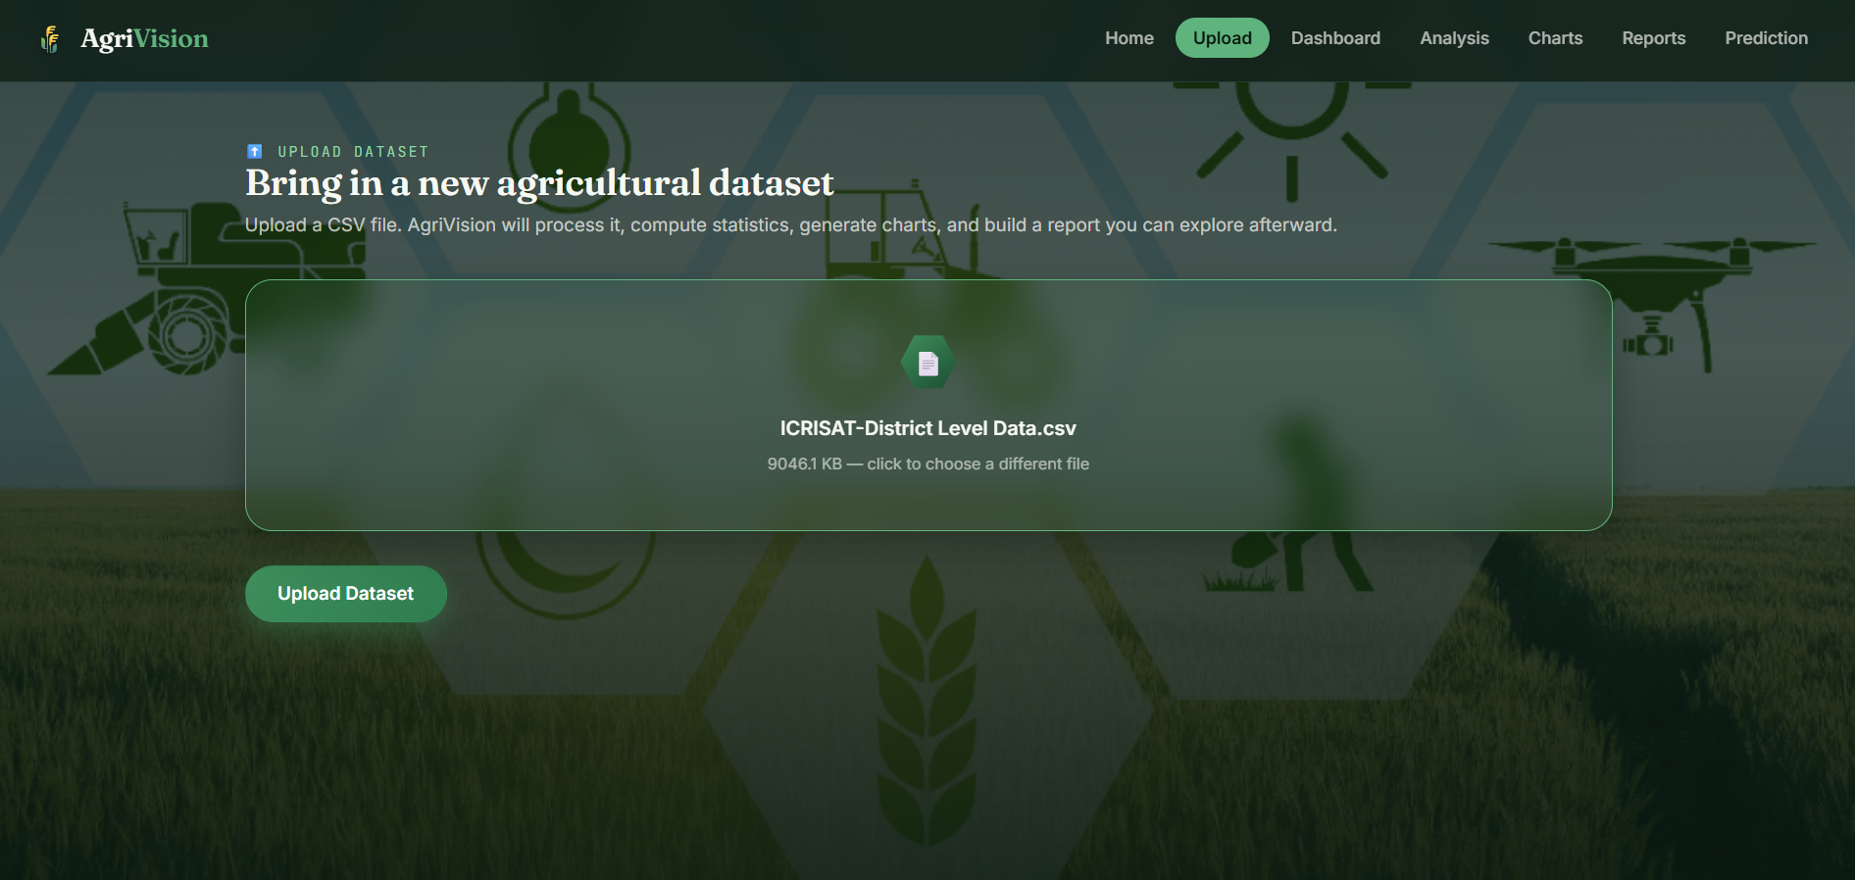
MODULE 1:IMPLEMENTATION

Slide 10
MODULE 2: Agricultural Data Analysis and Visualization
This module analyzes the uploaded agricultural dataset and generates meaningful statistical insights. It calculates important measures such as mean, median, standard deviation, minimum, and maximum values. The system also provides an agricultural summary, including common crop types, soil types, average rainfall, temperature, and crop yield. Various visualizations are generated to help users understand the data effectively.
Key Functions:
Statistical analysis
Agriculture data summary
Data quality assessment
Histogram generation
Box plot generation
Scatter plot generation
Heatmap generation
Bar chart generation

Slide 11
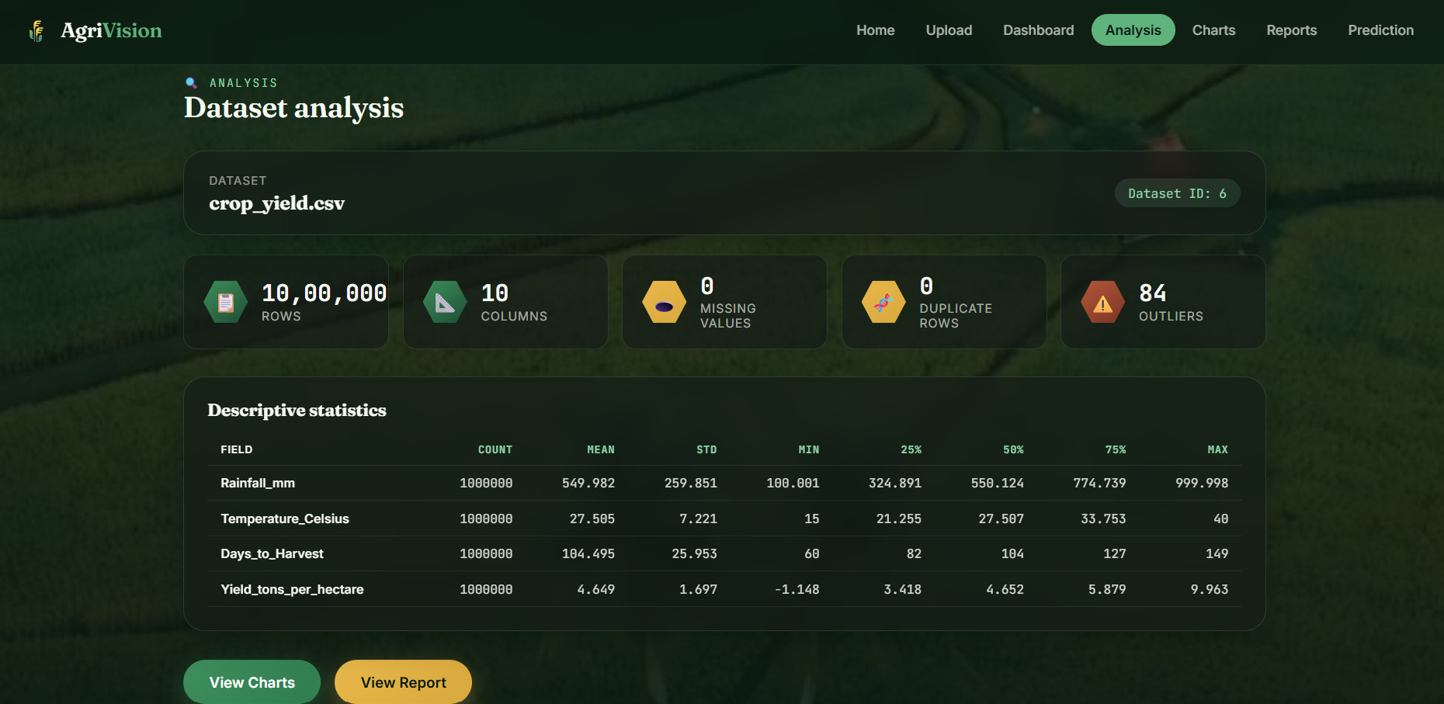
MODULE 2 :IMPLEMENTATION

Slide 12
MODULE 3: Dashboard, Reports and Result Management
This module presents the processed results through an interactive user interface. Users can view dataset information, analysis results, charts, and generated reports. The system stores dataset and analysis history in the database, allowing users to manage and access previous analysis results. A comprehensive report is generated based on the uploaded dataset and its analysis.
Key Functions:
Interactive dashboard
Dataset information display
Analysis result display
Chart visualization
Report generation
PDF report download
Database storage
Analysis history management

Slide 13
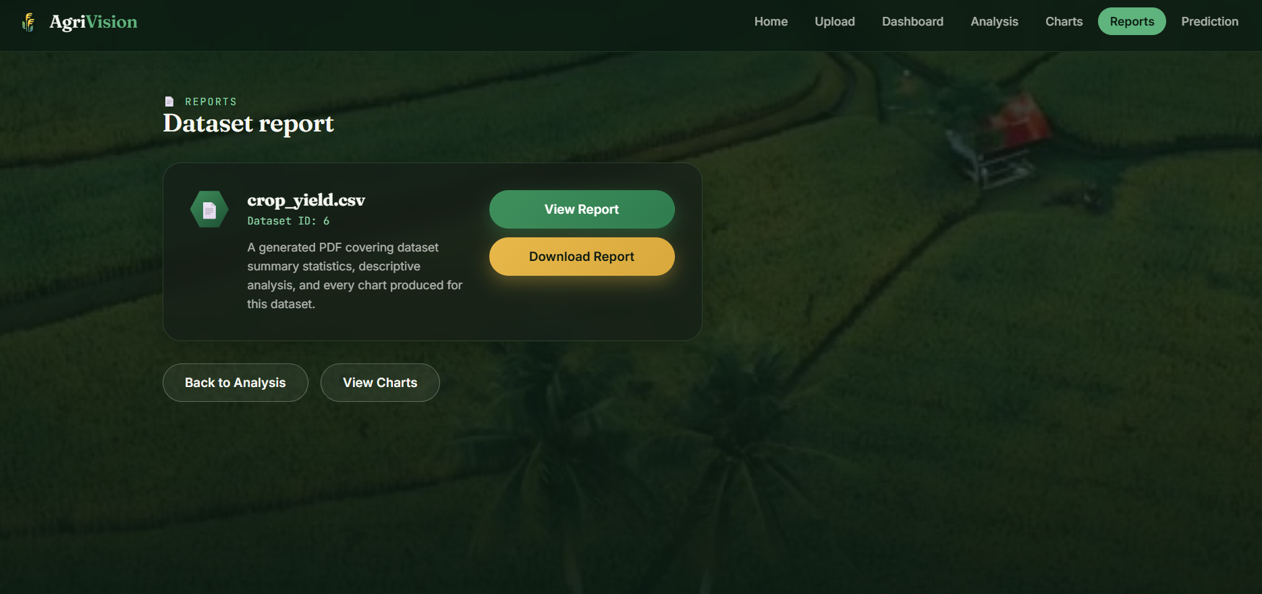
MODULE 3:IMPLEMENTATION

Slide 14
CONCLUSION
AgriVision provides intelligent crop recommendations using Data Science techniques.
The platform improves crop productivity by analyzing soil, weather, and historical data.
Interactive dashboards and reports make agricultural information easy to understand and interpret.
The platform promotes sustainable agricultural practices by enabling data-driven analysis aligned with SDG 2: Zero Hunger.
AgriVision serves as a practical Data Science application for agricultural analytics without relying on machine learning.

Slide 15
REFERNCES
R. V. Pellegrino, M. A. Santos, and L. F. Costa, “Nail Abnormality Identification Using Roboflow and YOLOv8,” Proceedings of the ACM International Conference on Intelligent Systems, pp. 1–6, 2024.
G. Shandilya, S. Gupta, S. Bharany, and S. Hussen, “Autonomous Detection of Nail Disorders Using a Hybrid Capsule CNN: A Novel Deep Learning Approach for Early Diagnosis,” BMC Medical Informatics and Decision Making, vol. 24, no. 1, pp. 1–15, 2024.
V. Gaurav, A. Sharma, and P. Verma, “Artificial Intelligence in Diagnosis and Management of Nail Disorders,” Indian Dermatology Online Journal, vol. 16, no. 1, pp. 25–34, 2025.
B. Galmés, G. Moyà-Alcover, P. Bibiloni, J. Varona, and A. Jaume-i-Capó, “Geometric-Based Nail Segmentation for Clinical Measurements,” arXiv preprint arXiv:2501.06027, Jan. 2025.
R. Nijhawan, A. Gupta, M. Diwakar, and P. Singh, “A Hybrid Model for Improved Nail Disease Classification Using Vision Transformers and Stable Diffusion,” Scientific Reports, vol. 16, Article no. 1544, 2026.

Slide 16
THANK YOU

